Slide 1
A Collaborative & Interactive Platform for Domestic Violence Agencies
Powered by W.O.M.A.N., Inc. & Force by Design

Slide 2
Who we are & What we do
24 Hour Domestic Violence Support Line
1979 – 25-30 calls per month
2010 – 24,000 calls per year
Notes:
JILL
Origins of the idea for the DVIRC:
WI was established in 1978 originally as two bed shelter for survivors. The organization quickly realized that additional options were needed for survivors who could not or did not want to enter shelter for a number of different reasons.
In 1979, the 24-Hour DV Support Line was created, and our agency began receiving approximately 25-30 calls per month. In 2010, we were receiving over 24,000 calls a year. We also became known as SF City’s Domestic Violence Support Line as we answered calls for 2 other DV shelters (Asian Women’s Shelter & Riley Center) in San Francisco, and today a trafficking agency as well (SAGE Project – Standing Against Global Exploitation).
One reason our agency received such a high volume of calls was that WI conducted a daily census of the San Francisco Bay Area DV agencies. WINC collected available DV bed information and dispatched it all day to survivors. Survivors, DV agencies, Other nonprofits, Hospitals, Law Enforcement, etc. called us for this information. In fact, we learned that 32% of our calls were from people who were requested immediate DV shelter bed information.
This strained staff/volunteer capacity and took attention away from providing peer counseling on the WINC 24/7 DV Support Line.
WINC shouldn’t be the holder of this information, yet we also knew that there were sensitivities around giving access information out about availability at a DV Shelter.
Idea to put the shelter census online; we’d update the info by 11am or so, and DV shelters would be able to access and update it throughout the day resulting in fewer calls to WINC for pure shelter census info
Initial census was created on wordpress.com, but didn’t meet with approval from then Executive Director who came from a tech background. The Executive Director took the idea and expanded it, wanted to get all resource user manuals (referral lists), and agency info online for all DV agencies to be able to access the system.

Slide 3
What is the DVIRC?
The Domestic Violence Information and Referral Center (DVIRC) is an online interactive community network that provides a safe space for member domestic violence service providers to share, network, and access updated information on services available in the Bay Area and beyond. It aims to ensure effective and appropriate resources and referrals can be offered to domestic violence survivors, their friends & families.
Notes:
This is the mission statement for the DVIRC project. This is a revision of the original mission statement. Because we have so many agencies involved in this project, WI established a steering committee that consists of DV advocates whose agency belongs to the DVIRC project. After the DVIRC had been in use for a few months, the steering committee got together and revised the mission statement to better articulate what the core of the DVIRC project consists of. --- As the mission statement was created by a partnership of organizations, this truly shows that the DVIRC is a collaborative project.
MARIYA
The Domestic Violence Information and Referral Center (DVIRC) is a collaborative effort of the Domestic Violence Agencies of the 9 counties in the San Francisco Bay Area counties.
This online, interactive database contains continually updated information necessary for DV agency staff to provide effective, efficient and appropriate client referrals.
The DVIRC also allows the domestic violence field to access best practices, training resources, and other information and materials to help build staff skills and/or organizational capacity.

Slide 4
Why Join?
· Members can access domestic violence shelter bed availability
Increase visibility of your organization’s programs & services – we had over 17,000 hits on the DVIRC in 2015
· Decrease/eliminate the cost of printed resource guides
· Access to high quality resource information – hundreds of filterable results
· Learn/share about local events & opportunities in the community
· Sharing best practices, training resources, and other information more easily
· Increase communication & collaboration in the DV community throughout the state
· Joining is free! You can have access to this valuable resource at no cost to your organization.

Slide 5
DVIRC History
In 2010, twenty-three DV agencies come together for a discussion about how to use technology to better understand what services were available to survivors and how could agencies enhance communications through a technological platform.
In 2011, though 23 agencies had been involved in the information gathering state, only 5 agencies signed a letter of agreement to join DVIRC.
In 2012, the DVIRC grew and within one year, 20 DV agencies had signed on.
Notes:
(Mariya Slide)
In 2010, our former ED invited twenty-three anti-domestic violence agencies throughout the 9 Bay Area counties to come together for a discussion about how to use technology so that they can better understand what services are available to survivors and so that the agencies can enhance communications amongst themselves.
23 agencies had been involved in the information gathering state, however, when I was brought onboard, there really were only 5 agencies who had signed a letter of agreement with WI to participate in 2011. They hired me to be the human contact or the person in-between the DV agencies and the programmers.
After I came onboard, the DVIRC grew to include many more agencies in the Bay Area. Within one year, we had 20 DV agencies signed on. With that growth, we had to figure out how to better provide support to all of the agencies to orient them to the system.

Slide 6
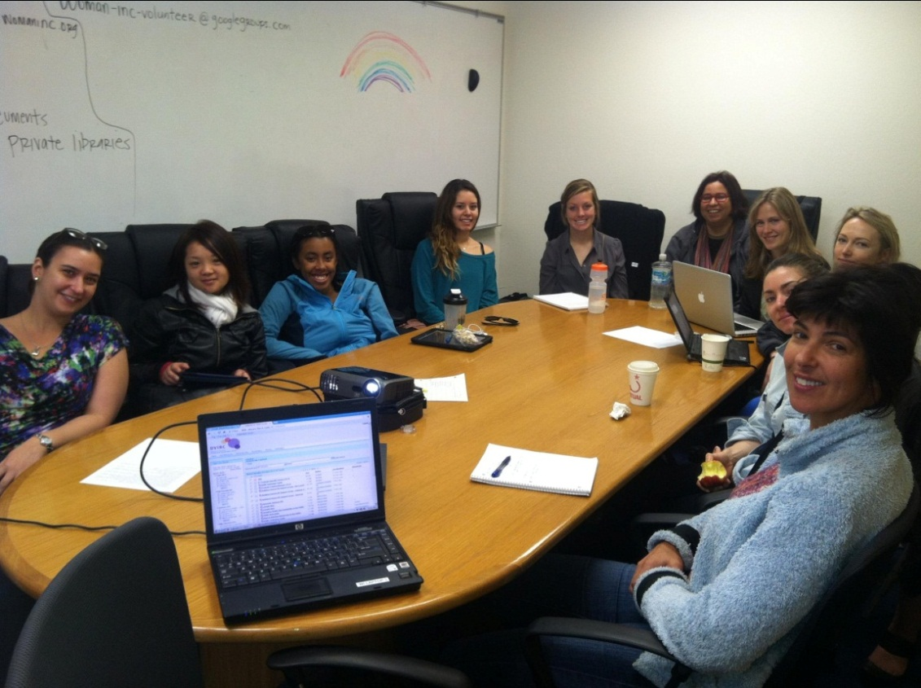
DVIRC HISTORY
March 23, 2013 – DV Support Line Volunteers being trained on using DVIRC during their volunteer shifts
Notes:
WI needed to incorporate fully b/f asking other agencies to do so:
At first lots of resistance to doing it citing lot of people have different ways of learning, easier to look at wall then look up resources (outdated info, lots of things crossed off)
Got ride of paper binders and Wall of Resources
WI incorporated the DVIRC and now all volunteers use it in many different ways, from using it for support line to also using it for the 40 hour training

Slide 7
DVIRC Statewide Expansion
Counties Covered:
2012
San Francisco Bay Area (9 counties)
2013
Santa Clara
2014
Del Norte
Ventura
2015
Los Angeles
Notes:
2012: Member agencies in 9 San Francisco Bay Area counties
2013: Expanded to include organizations in Santa Clara (Next Door Solutions, YWCA Silicon Valley, AACI, Asian Women’s Home)
2014: Expanded to include DV agency in rural Del Norte County (Rural Human Services) and Ventura (Coalition for family harmony)
Del Norte County –Rural Human Services’ Harrington House in Crescent City will be a beta-testing agency for a rural area. The agency has been delivering domestic violence services to survivors since 1981. They are located in one of the most rural and isolated areas in California, 365 miles north of San Francisco. A person must drive 100 miles south or 120 miles east to reach community larger than 50,000 people. Harrington House is an active community partner offering emergency domestic violence services, which include emergency shelter, adult and children individual and group counseling, legal aide, temporary restraining orders, domestic violence prevention education, tribal court advocacy, court accompaniment, food and clothing.
2015: Expanded expanded to include DV agency in Pasadena, CA (Los Angeles County), First DV Shelter added as member agency in 2016
Broadening our geographic scope is an endeavor we will continue to work on in the coming year.

Slide 8
DVIRC impact
2010
Received 24,000 calls
2013
34 Member agencies
Received 18,000 calls
2014
Creation of Analytics Report
16,000 hits on DVIRC
Received 10,000 calls
Notes:
JILL
February 2014: Force By Design Creates DVIRC Analytics Report
W.O.M.A.N., Inc. has also noticed a shift in the number of crisis line calls that our agency is receiving since the DVIRC has expanded to other agencies. – receiving 18,000 calls instead of 24,000 calls
In order to determine if there is a correlation between DV agencies updating their own shelter information and accessing the DVIRC versus calling WI for this information, we worked with our technical consultants, Force By Design, to build reports that will provide us with information regarding who is accessing the DVIRC system and what features are being accessed the most. We believe that there is a correlation between more DV agencies accessing the DVIRC and W.I. receiving less crisis line calls requesting shelter census information from other DV agencies. If proven, this positive change would indicate that our DVIRC partner agencies are utilizing the DVIRC to make more informed, holistic decisions about referrals for their clients.
Frees DV Support line for more in depth peer counseling with survivors

Slide 9
2014
Notes:
JILL AND MARIYA
-as calls to support line (for shelter census) go down, hits to the DVIRC go up.
-frees up time and capacity, allowing staff more reflective space, not live in crisis mode all the time

Slide 10
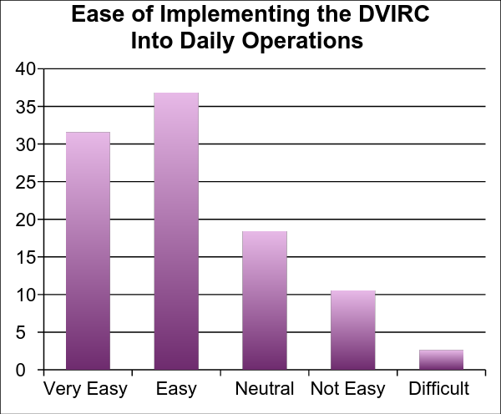
2014 End of Year Survey Results - Use of the Program
Most participants have seen a steady amount of DVIRC usage at their agency (69%) in the past six months. 22% have seen an increase of usage during that time period and only 8% have seen a decrease.
Participants have found it Very Easy or Easy to implement the DVIRC into their day-to-day operations.
Successful Methods of Implementation
Make or check on daily updates (i.e. space)
Use to find referrals and/or resources
Use while on crisis line
“We open the DVIRC each morning and use the resource to assist callers and other agencies for information.”
“We use the DVIRC all the time to get referrals and information to survivors of Domestic Violence.”
“As the helpline is the one shop stop for resources within the agency, we have included training on how to use DVIRC website to our Helpline training. So when anybody in the agency needs information DVIRC can provide, Helpline staff provide them the relevant information. “
Notes:
In November 2014, we put together a survey to assess how the DVIRC was impacting the survey participants in their day to day work.

Slide 11
DVIRC Impact on field
Technology can build a stronger, coordinated network of domestic violence service providers.
The DVIRC has made a positive impact in case management and goal setting
80% of member agency representatives who took our 2014 DVIRC check-in survey said they saw a significant positive impact on their agency’s functions
Respondents also reported the DVIRC helps them:
Save time & improve efficiency when contacting shelters.
Use and access relevant information with ease.
Feel better prepared to assist callers.
Familiarize new staff/volunteers to the Bay Area agencies.
Share pertinent information and resources to other agencies in the network.
Notes:
JILL
Presentation Objectives: (Give examples of each)
Learn how to successfully incorporate technology into the domestic violence field to build a strong, coordinated network of domestic violence service providers.
Ex/ DVIRC has 35 agencies accessing it now
2) Learn how technology can be utilized when establishing and building collaborations.
Ex/Technology can offer ease when communicating and coordinating services offer a space to exchange ideas and can be supportive when offering referrals and resources to volunteers.
3) Learn how the DVIRC has made a positive impact in case management and goal setting
offering downloadable and printable resource guides tailored to meet specific client needs. These can be pivotal when offering case management and help survivors move toward meeting their case management goals.
Survey shows how the DVIRC has helped advocates better serve those accessing their programs.
Save time & efficiency when contacting shelter
While the ultimate goal is to encourage DV shelters to update their shelter info independently, W.O.M.A.N., Inc. advocates still call a select group of shelters to update the shelter census. Updating this information on the site is simple and allows us to instantaneously share the shelter information with the DVIRC network.
Feel better prepared to assist callers
Relieve advocates from the extra step of calling W.O.M.A.N., Inc. when assisting clients – they can access the information they need themselves.

Slide 12
Next Steps
Update & clean existing resources
Working with Force by Design on improvements to the backend of the system
Continue strategy to recruit DV agencies
(How best to scale the DVIRC)
Continuing collaborations & communication with existing member agencies
Explore ways we can become more accessible to ESL advocates – we are currently working on translating our handouts & brochures in Spanish.
Notes:
Update & clean existing resources
In hopes of strengthening the integrity and collaborative nature of the DVIRC, we have been brainstorming ways in which we could make this database more efficient. Since its conception, we’ve been able to collect hundreds of resources throughout the Bay Area and beyond. On a positive note, this pushes us closer to the goal of being better connected with all those working in our fields. On a critical note, we understand that as our pool of resources becomes more abundant, it becomes increasingly more difficult to filter through and provide referrals that best fit the needs of those we serve. To begin this process we 1) Recruited volunteers to go through each listing and make sure all resources are up-to-date and relevant; & 2) surveyed our DVIRC community members to provide us with the programs and services they find themselves referring out to most often. We know each member agency has a unique set of skills and expertise, and wanted to capture the networks they’ve created independently. We look forward to implementing our findings in the strengthening of our database.
Strategy to recruit DV agencies ( How best to scale the DVIRC) - There are 58 counties in CA
Reach out regionally and use these existing networks to establish relationships and expand DVIRC
Connect through Leadership Development Program (Strongfield Project)
There are about 28 LDP agencies who are not members of the DVIRC
Compass Point
CPEDV (state coalition)
6 regions– approximately 123 DV agencies in CA who are members
Continuing to ensure the collaboration btwn DV agencies
Increasing members in the DVIRC steering committee (Network/leadership opportunities)
Regional Directors (engage and cultivate emerging leaders) such is done with CPEDV
Regional meetings/trainings – webinars (was trying to have individual agencies trainings previously with the 35 agencies)
Further utilization of the Community Section of the DVIRC
Learn how the Community Section caters for different audiences in the DV field
Executive Directors vs. Front Line Advocates (leadership versus advocates)
WI Volunteer 40 hour training remodeled – recreating the 40 hour DV training to become more accessible to volunteers who may live far from a DV shelter (such in rural locations) – a hybrid training combining online & in-person training and using the DVIRC for the online portions
Our WI Executive Directors is the Liaison for the 2nd LDP Cohort. This cohort is submitting an LOI to the Blue Shield Foundation to continue the collaboration beyond their LDP years. She has pitched using the DVIRC as their form of communication and sharing of knowledge via the features found on the community section.
Store information on the DVIRC

Slide 13
Website Overview
Finding Resources
Filterable results & keyword search
DV Shelter availability
Saved Resource Lists
Saved Filters
Community
Get Ideas
Get Answers
Reference Documents
Calendar of Events

Slide 14
Resources On DVIRC
Children’s Resources
Disability
DV Resources
Advocacy
Batterer Resources
Crisis Line
Peer Counseling
Case Management
Outreach
Restraining Orders
Shelters
Support Groups
Therapy
Advocate Training
Counseling
Peer Counseling (Family & Individual)
Peer Support Groups
Educational Workshops
Employment Services
Health Services
Mental Health
HIV/AIDS Resources
Housing Resources
Shelters
Transitional Housing
Financial Support
Financial Aid /Financial Guidance
Food/ Clothing
Immigrant Resources
Law Enforcement/Criminal Justice
Legal Services
LGBTQ
Parenting Skills
Pet Care & Shelters
Senior Resources
Sexual Assault/Rape
Sex work/Trafficking
Substance Abuse Resources
Teen/ Youth Resources
Transportation
Victim Services
Volunteer Opportunity
Notes:
Children’s Resources include – Child Care, Child Care during support group, etc.
Housing Resources include – Info on Evictions, homeless shelters, information lines, rent assistance, transitional shelters, etc.

Slide 15
DVIRC Member Agencies
San Francisco
Arab Cultural and Community Center (ACCC)
Asian Women’s Resource Center/Gum Moon Women’s Residence
Asian Women’s Shelter
Asian Pacific Islander Legal Outreach
APA Family Support Services
Bay Area Legal Aid
Community United Against Violence
Donaldina Cameron House
Homeless Access Project/SF Home
Jewish Family and Children’s Services – Dream House
Justice and Diversity Center
Legal Aid Society - Employment Law Center
Riley Center – Saint Vincent de Paul Society
Safe Start
San Francisco Department on the Status of Women
San Francisco Sherriff’s Department; Survivor Empowerment Program
Victim Services Division
Volunteer Legal Services Program/BASF
W.O.M.A.N., Inc
Ventura County
The Coalition for Family Harmony, Oxnard
Los Angeles
Shepherd’s Door
Good Shepherd Shelter
Rainbow Services
Alameda County
A Safe Place
Alameda County Family Justice Center
Building Futures with Women and Children
DeafHope
Family Violence Law Center
Shalom Bayit
Narika
Safe Alternatives to Violent Environment (SAVE)
Ruby’s Place
Sacramento County
My Sister’s House
WEAVE
San Mateo County
Community Overcoming Relationship Abuse (CORA)
Santa Clara County
Asian Americans for Community Involvement (AACI)
Maitri
Next Door Solutions to Domestic Violence
Support Network For Battered Women, YWCA
Community Solutions
NISA
Del Norte County
Rural Human Services Harrington House, Crescent City
Notes:
MARIYA
Today, 35 agencies throughout California are utilizing the Domestic Violence Information and Referral Center (DVIRC).

Slide 16
DVIRC FUNDERS
Notes:
It has been funded by the Strong Field Project (jointly funded by the Women’s Foundation of California and Blue Shield Against Violence Program), the Verizon Foundation, the Blue Shield Foundation of California, and the David B. Gold Foundation.
Grants for DVIRC Project (no need to mention costs unless asked)
Strong Field Project (Collaboration btwn Blue Shield and Women’s Foundation in CA)– $100,000
Funding to move forward on the implementation and initial testing of the DVIRC .
Strong Field Project began in 2010. Originally was a 4 year program to strengthen the DV Field in CA. They have a Leadership Development Program and an Organizational Strengths Grants program. We received an Organizational Strengths Grant to move the DVIRC from the implementation to initial testing of the DVIRC.
Verizon Foundation gave about 10-20K – technical support for the project
Blue Shield Foundation – $230 K – Because they were so happy with the outcomes of the Strong Field Project Grant, they invited our agency to test what the expansion of the DVIRC to a rural area (Harrington House in Crescent City – Del Norte County) and suburban area (Coalition for Family Harmony in Oxnard – Ventura County). And see how an entire county (Santa Clara County) can utilize the system since all of the agencies were members of the system already.
David B. Gold Foundation - $10,000 to further strengthen the tool and its integration with the W.O.M.A.N., Inc. 24-hour domestic violence support line.
No need to mention costs unless asked:
Approx. 500 K – Total of Grant Projects

Slide 17
DVIRC Contact Information
“Usually clients needing shelter need to make multiple calls to many shelters to determine if bed space is available. With the DVIRC, we are able to give clients a list of shelters with possible space, saving them the time and frustration of calling every shelter in the area.” - Nazgol, Alameda County Family Justice Center
“The DVIRC helps us to increase communication and collaboration in the domestic violence community throughout the state. We are able to share best practices, get training resources, and have access to many resourceful documents in the community tab.” - Patricia, Next Door Solutions
"The DVIRC is a one stop shop that provides a myriad of information...It is a relief to have immediate online access to continually updated resources.” - Lisa, Shalom Bayit
(415) 969-6761
dvirc@womaninc.org
Notes:
BOTH
These are the features now available on the website. We would like to implement additional features in the future as more users gain access and we better understand the needs of DV agencies through this website.
Examples: alert system, internal agency communication, etc.

Slide 18
Questions?
Concerns?
General thoughts?
Notes:
Presentation Objectives:
Learn how to successfully incorporate technology into the domestic violence field to build a strong, coordinated network of domestic violence service providers.
Ex/ DVIRC has over 34 agencies accessing it now
2) Learn how technology can be utilized when establishing and building collaborations.
Ex/Technology can offer ease when communicating and coordinating services offer a space to exchange ideas and can be supportive when offering referrals and resources to volunteers.
3) Learn how the DVIRC has made a positive impact in case management and goal setting
offering downloadable and printable resource guides tailored to meet specific client needs. These can be pivotal when offering case management and help survivors move toward meeting their case management goals.

